Slide 1


Trans Day of Remembrance
Harper Sarasin for IASFAA DEI Committee

Slide 2

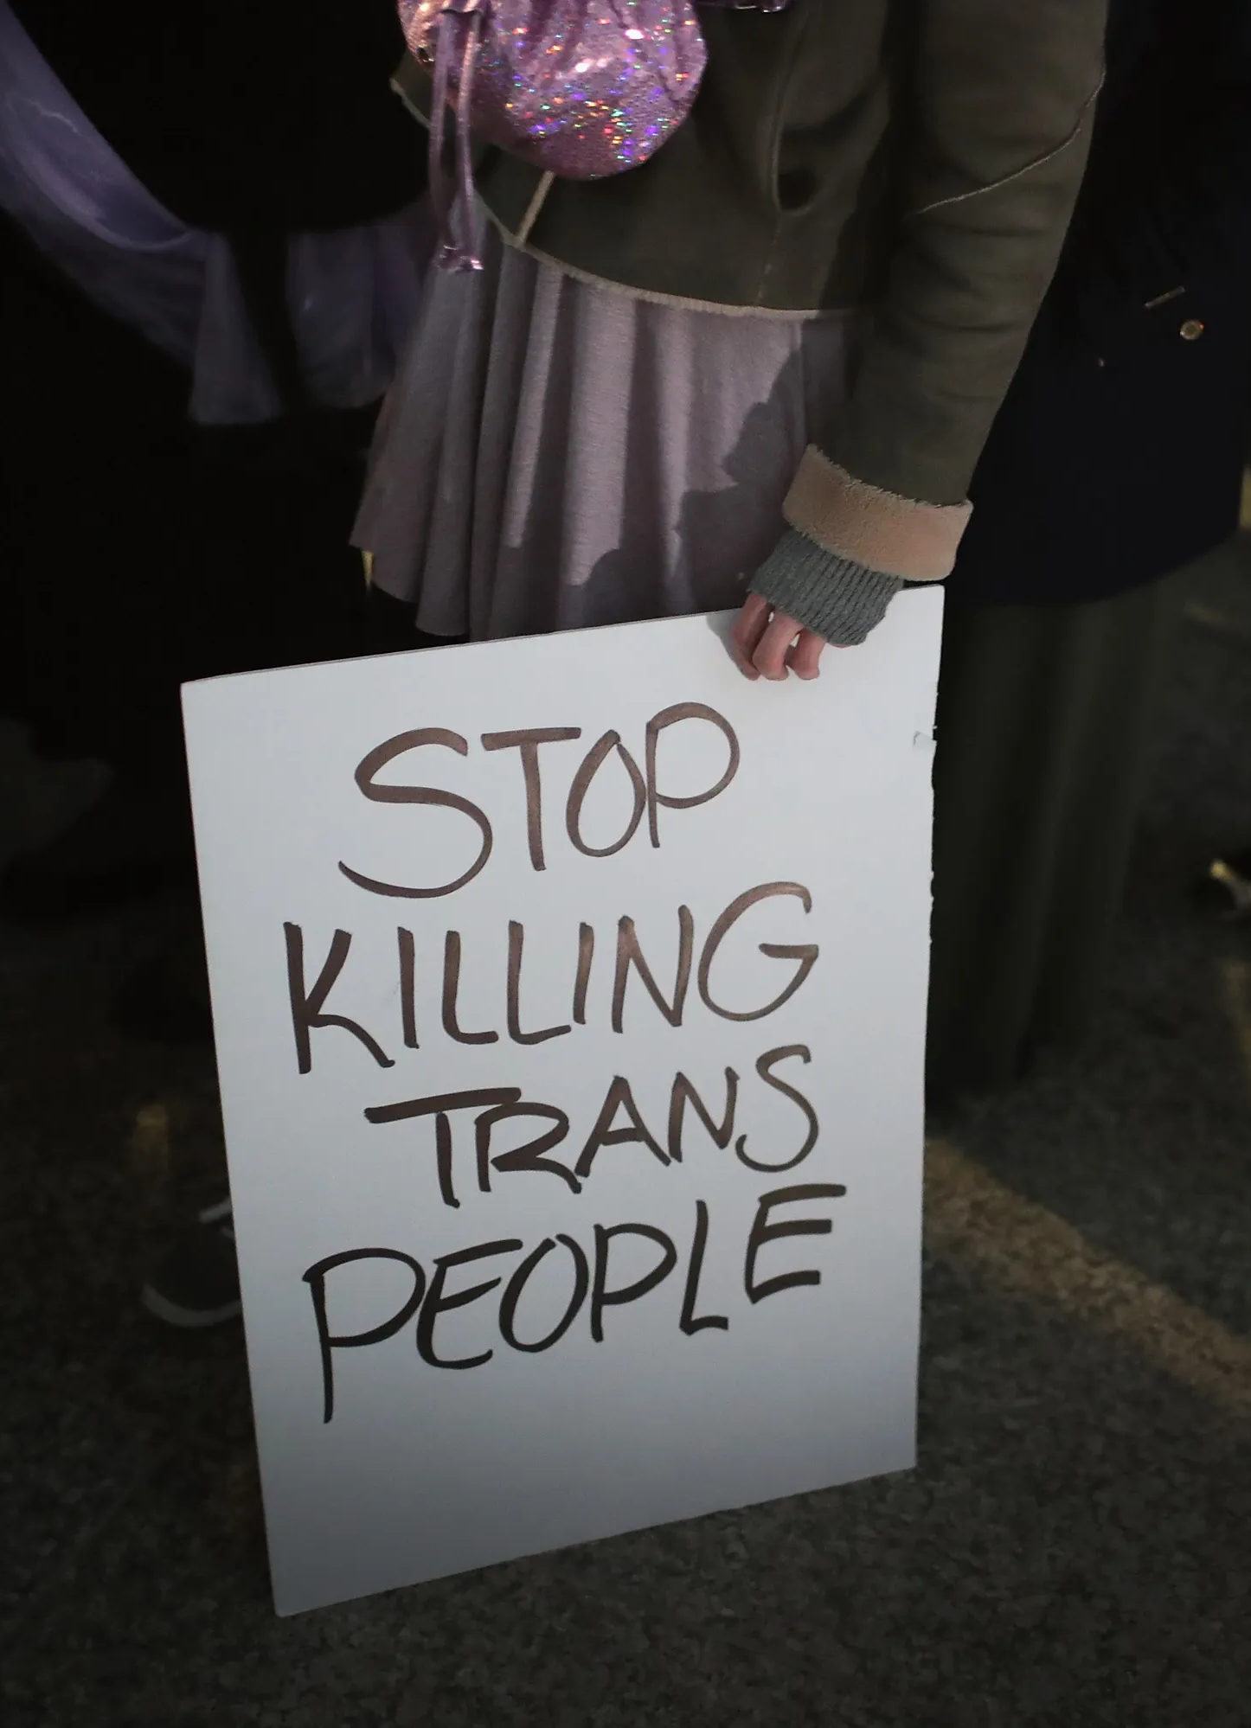
TABLE OF CONTENTS
01
Introduction
02
What Do I Do With This Day?
03
The Rest of the Year
04
In Loving Memory
Why TDOR exists
Honoring TDOR
Allyship year round
Remembering those lost in 2021

Slide 3
Introduction
01
Why do we have Trans Day of Remembrance?

Slide 4

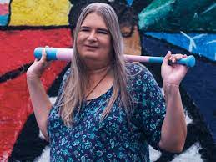
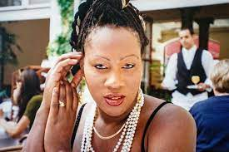
INTRODUCTION
Trans Day of Remembrance is observed on November 20th.
It was founded in 1999 by Gwendolyn Ann Smith in memory of Rita Hester, a trans woman who was murdered in 1998.

Slide 5
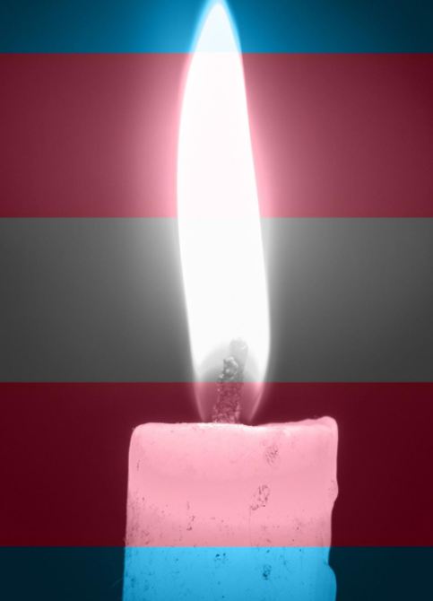
—Gwendolyn Ann Smith
“Transgender Day of Rememberance seeks to highlight the losses we face due to anti-transgender bigotry and violence. I am no stranger to the need to fight for our rights, and the right to simply exist is first and foremost. With so many seeking to erase transgender people – sometimes in the most brutal way possible – it is vitally important that those we lose are remembered, and that we continue to fight for justice.”

Slide 6

STATISTICS
44
20
52%
of those victims were Black trans women.
murders of transgender and nonbinary people were reported in the US in 2021.
of trans and nonbinary people ages 13-24 that considered suicide in 2020. 20% attempted suicide.

Slide 7
What do I do with this day?
02
Observing Transgender Day of Remembrance

Slide 8

ACTIONS FOR ALLIES
Gather
Share
Research
Donate
Seek out vigils and other memorial events in your community
Bring friends and family with you to the events you attend, and educate the people around you.
Look up news about the trans people being remembered each year, learn about their lives, remember them and their legacies.
If you are able, support organizations that protect the trans community either financially or as a volunteer.

Slide 9

ORGANIZATIONS TO SUPPORT
The Trevor Project
Point of Pride
OneIowa
CenterLink
Sylvia Rivera Law Project
Matthew Shepard Foundation
Mental health and suicide prevention for LGBTQ+ youth
Provides gender affirming garments and healthcare to trans people with financial need
Intersectional advocacy & resources for LGBTQ+ Iowans
International network of non-profit LGBTQ+ resource and community centers
Legal services for transgender people
Hate crime prevention and LGBTQ+ advocacy

Slide 10
03
The rest of the year
Fostering safer communities

Slide 11
THE SMALLEST MOMENTS HAVE THE LARGEST IMPACT

Slide 12
DOS AND DON’TS
Ask a trans person their deadname
“I’m trying, it’s just hard for me to remember”
Make a scene apologizing
Expect emotional labor from trans people you know (especially without compensation)
Make space for people to try new names and pronouns
Educate yourself
Speak up against transphobia and gender discrimination
Ask questions politely and respect people’s boundaries

Slide 13
GENDER TERMS TO KNOW
AFAB: Assigned Female At Birth
AMAB: Assigned Male At Birth
Cisgender: Identifying with the gender assigned at birth
FTM: Female To Male
MTF: Male To Female
HRT: Hormone Replacement Therapy
Deadname: The name a transgender person was called before transitioning.

Slide 14



GENDER TERMS TO KNOW
Transgender
Non-binary
Agender
Identifying with a gender other than the one assigned at birth
Identifying with a gender outside of the male-female binary
Not identifying with any gender

Slide 15


GENDER TERMS TO KNOW
Genderfluid
Genderqueer
Gender identity that changes across time between varying binary or non-binary genders
Another umbrella term for folks who do not identify as cisgender, and usually identify outside/beyond the male-female binary

Slide 16
In Loving Memory
04
Say their names

Slide 17
THOSE LOST IN 2021
Marquiisha Lawrence
Jo Acker
Jessi Hart
Mel Groves
Royal Poetical Starz
Kier Solomon
Brianna Ulmer
Disaya Monaee
Pooh Johnson
Miss CoCo
Shai Vanderpump
Taya Ashton
EJ Boykin
Zoella Martinez
Tierramarie Lewis
Oliver “Ollie” Taylor
Poe Delwyn Black
Serenity Hollis
Danny Henson
Sophie Vasquez
Whispering Wind Bear Spirit
Thomas Hardin
Keri Washington
Tiffany Thomas
Iris Santos
Natalia Smut Lopez
Jahaira DeAlto Balenciaga
Tiara Banks
Remy Fennell
Dominique Lucious
Jaida Peterson
Rayanna Pardo
Diamond Kyree Sanders
Aidelen Evans
Jenna Franks
Jasmine Canady
Jeffery “JJ” Bright
Chyna Carillo
Alexus “Kimmy Icon” Braxton
Fifty Bandz
Dominique Jackson
Bianca “Muffin” Bankz
Samuel Damian Edmund Valentin
Tyianna “Davarea” Alexander

Slide 18
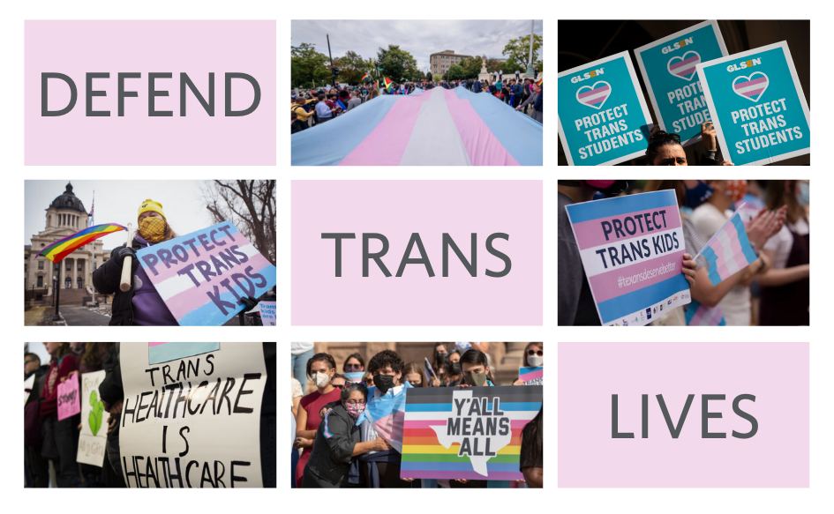
Questions?
hsarasin@coe.edu
319-399-8540

Slide 19
RESOURCES
https://www.glaad.org/tdor
https://www.glaad.org/blog/tdor-memoriam
https://www.thetrevorproject.org/survey-2021/

